Slide 1
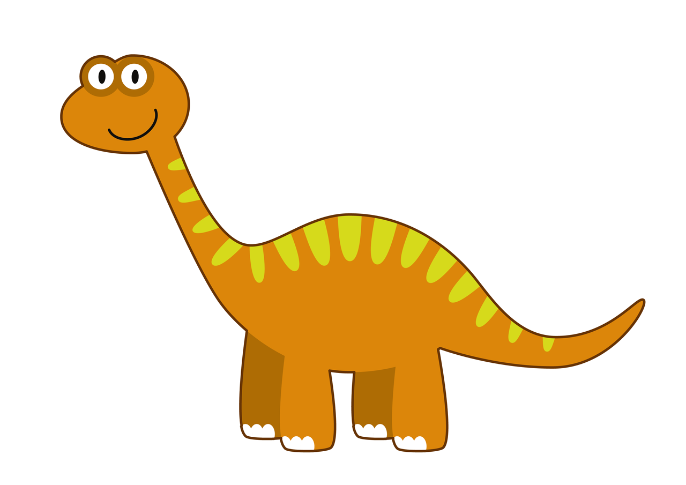

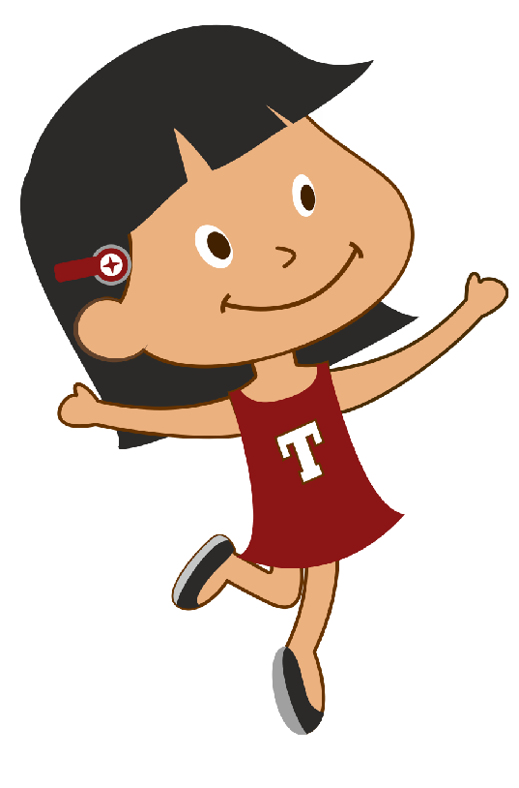

<Insert Header>
Hi I am Tina!
Lets go exploring the dinosaur world fearlessly!
Mommy dinosaur and baby dinosaur are exploring the grasslands. But Baby Dinosaur is hungry and wants to eat a plant snack.
Can you help baby dinosaur get a plant snack ?
Click on the play button to get started.

Slide 2


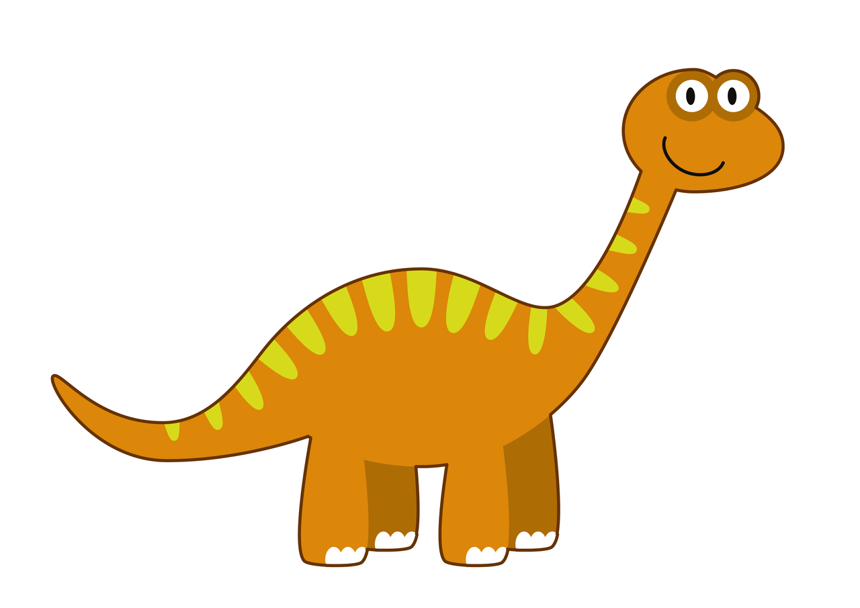
<Insert Header>
Lets take a look at how you can get a plant snack for baby dinosaur!
Every time you see a plant snack, click on it!
That way, baby dinosaur will get a plant snack.
Click on the play button to get started.

Slide 3
<Insert Header>
Help baby dinosaur get a plant snack!
The plants have to appear in random spots on the screen.
Child has to click the plants.
When child gets a plant, then the correct audio plays.
BIRD CHIRPING AUDIO PLAYS IN THE BACKGROUND

